Slide 1
New Approaches to Economic Challenges
Trade, Growth & Competition
Presenter: Masud Cader
OECD Workshop on Complexity and Policy

Slide 2
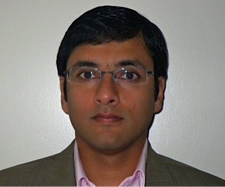
A bit about me
Masud Cader serves as the Lead of Country Analytics for the International Finance Corporation, the private sector arm of the World Bank Group. In this position Masud is responsible for strategy integration of large cross-country initiatives such as One Belt One Road, and applying analytics to create novel insights that link development strategy with private sector client implementation.
Masud also co-heads the World Bank Group-IMF Economic Networks practice. He has over 20 years of experience in corporate finance, sustainable investing, investment management, equity and credit portfolio management, trading, and use of artificial intelligence to manage difficult development problems. Masud has degrees from Purdue University, American University, and Johns Hopkins University. He also teaches research courses at Georgetown University, McDonough School of Business.

Slide 3
Some history of Economic Complexity at World Bank
1993 - World Bank treasury trading strategies based on CAS/nonlinear dynamics
2003 – Identifying seemingly unrelated risks in the business portfolio
2004 – Analyzing existing sponsor/investor networks to build client engagement
2005 - Know every client in a country and estimate relationship dynamics
2007 – Product competition (e.g., in pharma market: disease-treatment-api)
2011 - Identify mega trends and how they interrelate dynamically
2012 – Dimensions of trade
2013 - Sustainability networks (segmentation based on sustainability)
2016 – Fitness adopted for country strategy

Slide 4
Current Country Strategy Applications of Fitness Ensemble
Identify development constraints with an emphasis on private sector across countries, and segment countries facing similar combinations of development challenges
Provide in-depth sector insights based on country capability, competitiveness and development fit
Explore potential of service exports, and interplay between services and products into country and sector strategies
Adoption has been relatively quick, why?
New analytics embedded in utility – incredible focus on results and not techniques!
Real world calibration is continuous
Using dynamics to inform predictive models

Slide 5
The World is Dynamic and Development Strategy via Private Sector Should Lead the Way
Retail
Manufacturing
SMEs
Ensures the flow of accurate and efficient information between people and systems
Substantial productivity and export gains for SMEs
“Industry 4.0”
Gains in time / efficiency;
Expedited production;
Reduced transaction costs;
Enhanced supply chains
Disruptive Technology
???
???
Sector impact
Trade
Infrastructure
Development impact
Utilities
Solar power -- with the potential for electricity prices to fall significantly
Smart grids allow for better network connectivity —enable objects to collect and exchange data (e.g. smart metering)
Improves reliability and reduces costs
Education Services
Health Services
Unparalleled distribution service that broadens consumers’ access to:
Access to Finance
Health and Education Services
Food
Permeates all services, from basic necessities (including social safety nets), to key human rights such as health and education
???
???
Manufacturing
Agri-business
Financial Services
Agri-business
Long-term trends:
Artificial intelligence and robotics (also driven by computing power and data storage) → drastically increases levels of automation and efficiency in all segments of the economy including job market disruption
Genomics (also driven by computing power and data storage) → disruption to Agribusiness and health care, fundamental transformation of diagnosis and treatment
Others: 3-D printing, nanotechnology

Slide 6
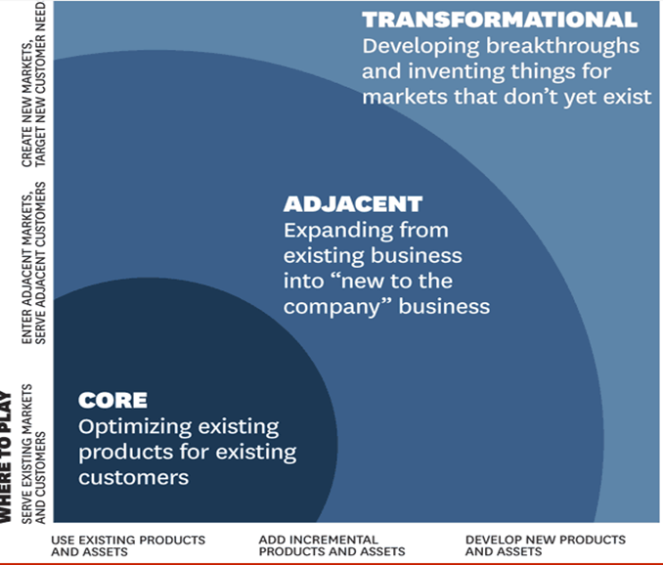
do new things OR do things differently to create new value
What do we mean by innovation?
do new things – A widely used external distinction*:
Core – An improved offering
Adjacent - An offering new to a specific market
Transformational – A breakthrough solution
do things differently - also the process of innovation**
Create new value – sustainable business and impact that can be scaled
Innovation critical to help transform Billions into Trillions and create markets
* Graphic from HBR: Managing Your Innovation Portfolio, Bansi Nagji and Geoff Tuff, May 2012.
**Internal operational BPI excluded

Slide 7
Challenges
Overcoming current economic inertia
Traditional equilibrium philosophy permeates both strategy and understanding of development issues
Is economic complexity too much about anticipating “phase” changes?
Does EC only yield risk management tools?
How is adoption of economic complexity accomplished?

Slide 8
Annex

Slide 9
Key Concepts
Revealed Comparative Advantage (RCA): RCA indicates whether a country is in the process of extending the products in which it has a trade potential, as opposed to situations in which the number of products that can be competitively exported is static. It can also provide useful information about potential trade prospects with new partners.
Product Progression Network: A network of different products connected by directed link which represent a causality relationship.
Complexity: measure of capabilities needed to produce a product. Product requires low capability = less complex product (generally low margin, volume product) high capability = more complex product (generally higher margin, low competition, specialized)
Fitness: Diversification of weighted Complexity for each Country. Measure for country’s industrialization level and future prospects of growth.
Density: Ease of market entry to produce a product – level of possibility or proximities of the product to other products the country is already good at exporting.
Growth Segmentation: Organizes 178 countries into 15 segments by similarity across projected growth/constraint profile (2009-2014) - business operation environment, economic performance, macro environment, and market potential (e.g., demographic trend of future consumers, access and nature of underserved markets).

Slide 10
The Analytical Approach in a Nutshell
Product Network
A network of different products connected by directed link which represent a causal relationship
Based on conditional probability: if product A is produced when product B already produced, product A shares a set of capabilities with product B
B
A
The model uses Capabilities Approach
Capabilities of a country enables it to produce a given product
The presence or absence of products in a country’s export basket represents a hint to the capability basket of this country
If many countries have Product A in their export baskets(i.e. competitively produced), such product requires low capability
If only few countries have Product B in their export baskets, such product requires high capability
Basket of products predict future development of competitive products in 5 years

Slide 11
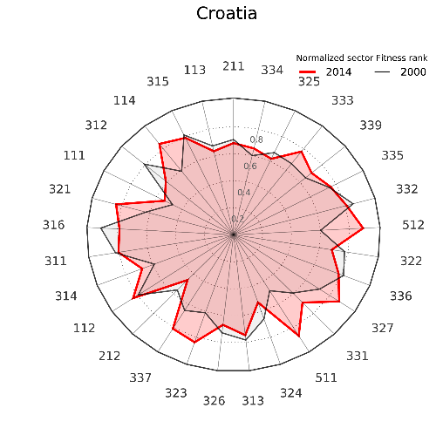
Interpreting Sector Fitness radar plots
Country
Least complex sector
Most complex sector
In 2014, Croatia’s normalized fitness rank in sector 333 was nearly 0.8 (compared to about 0.65 in 2000).
Increasing complexity:
Sector 321 is more sophisticated than 111
Red line above black line (as indicated by a bright red region): Fitness in this sector has improved between 2000 and 2014
Black line above red line:
Fitness in this sector has decreased since 2000. Croatia’s strength in producing these goods is diminishing.

Slide 12
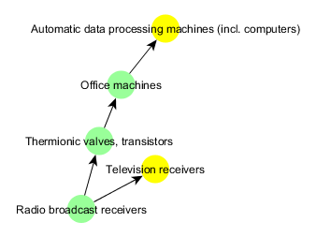
Interpreting Product Progression Networks
Goods in a product progression are connected by directed links which represent a causality relationship:
Good A is usually produced after a country is able to produce good B
B
A
Example progression:
Higher-complexity goods are at the ends of the network
Interpretation:
Office machines and computers are connected, because they require similar capabilities for their production.
Since this country is able to produce office machines competitively, it can also become competitive in data processing machines.
Yellow nodes represent the country’s non-competitive exports.
Low-complexity product at the beginning of the network
Green nodes are already competitively exported by the country.

Slide 13
A snapshot of what fitness means…
Logistics
Bank Capital Adequacy
Population Growth
Ag Employment
Tax Rates
Labor
Debt Service
Infrastructure
GVCs
LT Econ Risk
Science & Technology

